Slide 1

A-CLUSTER
All-Weather
Macro Regime Portfolio
Four-sleeve European-listed UCITS/ETC implementation designed for recession, recovery, crisis, and inflation regimes.
Risk Parity
4 Regimes
Monthly
Default allocation rule
Macro environments
Review & rebalance
Data source: Yahoo Finance | Generated from uploaded HTML backtests and Monte Carlo reports
A-CLUSTER All-Weather / Macro Regime Portfolio | Yahoo Finance data | Monthly rebalance
1

Slide 2
Executive summary
Forward-validation Risk Parity results for a compact four-sleeve portfolio designed for resilience across macro regimes.
19.9%
1.18
0.25
8.0%
78/100
Annualized return
Sharpe ratio
Beta to S&P 500
Max drawdown
A-CLUSTER score
CORE CONCLUSION
STRATEGIC IMPLICATION
Each instrument is assigned a distinct macro role; no single environment is expected to dominate.
Risk Parity and Equal Weight performed very similarly, confirming that ETF selection drives much of the result.
The portfolio is an independent All-Weather / Macro Regime UCITS/ETC implementation—not a traditional 60/40.
Keep the universe confined to the four chosen instruments.
Treat monthly rebalancing as risk management—not short-term trading.
Use Risk Parity as the default; Equal Weight remains the benchmark and fallback, while optimization is diagnostic.
A-CLUSTER All-Weather / Macro Regime Portfolio | Yahoo Finance data | Monthly rebalance
2

Slide 3
One portfolio, four macro environments
Each sleeve is selected for a different economic and market regime.
XDEB
IS3S
PHPM
LYTR
Recession / risk-off
Expansion / recovery
Crisis / falling real rates
Inflation / commodity booms
Defensive equity
Value equity
Precious metals
Broad commodities
No single macro scenario dominates. The portfolio balances growth, inflation, monetary stress, and drawdown risk within a compact European-listed UCITS/ETC universe.
Identity: Independent A-CLUSTER All-Weather / Macro Regime Portfolio (European-listed UCITS/ETC implementation)
A-CLUSTER All-Weather / Macro Regime Portfolio | Yahoo Finance data | Monthly rebalance
3
Notes:
[Sources]
- https://www.bridgewater.com/research-and-insights/the-all-weather-story
- Bridgewater is a conceptual reference only. A-CLUSTER is an independent UCITS implementation with no claimed affiliation.
[/Sources]

Slide 4
Four instruments map to four macro regimes
Each sleeve has a distinct job; none is redundant.
Ticker
Instrument
Asset / factor
Primary role
Best macro regime
XDEB.DE
Xtrackers MSCI World Minimum Volatility
Global low-volatility equity
Defensive growth / lower beta
Recession, slowdown, risk-off
IS3S.DE
iShares Edge MSCI World Value Factor
Global value equity
Equity return engine
Expansion, recovery, value rotation
PHPM.MI
WisdomTree Physical Precious Metals
Physical precious metals
Crisis hedge / monetary hedge
Geopolitical or financial stress; falling real rates
LYTR.DE
Amundi Bloomberg Equal-weight Commodity ex-Agriculture
Broad commodities
Inflation hedge / real assets
Inflation, supply shocks, commodity booms
DESIGN PRINCIPLE
The portfolio is deliberately compact: every sleeve must represent a distinct macro regime.
Monthly rebalancing restores the intended risk balance as prices and correlations change.
A new asset is justified only when it adds a genuinely different behavior cluster.
A-CLUSTER All-Weather / Macro Regime Portfolio | Yahoo Finance data | Monthly rebalance
4

Slide 5
XDEB | Defensive global equities
Xtrackers MSCI World Minimum Volatility UCITS ETF 1C | Provider facts at 31 Jul 2026
Characteristic
Details
Ticker / ISIN
XDEB.DE / IE00BL25JN58
Provider / domicile
Xtrackers (DWS) / Ireland
Replication / income
Physical / accumulating
Fee / launch
0.25% p.a. / 5 Sep 2014
Benchmark / coverage
MSCI World Minimum Volatility Index (TRN) / developed large & mid cap
285 constituents; quarterly index review. A rules-based defensive equity sleeve—not a guarantee of smaller losses.
A-CLUSTER All-Weather / Macro Regime Portfolio | Provider factsheets
5
Notes:
[Sources]
- https://etf.dws.com/download/asset/51fb5c6f-e957-4da5-9dff-c2a18ef57eee
- Product facts are provider-sourced; behavioral descriptions are A-CLUSTER research interpretation.
[/Sources]

Slide 6
XDEB | Minimum-volatility design
The optimizer targets portfolio-level risk while preserving broad diversification.
Portfolio optimization
Defensive equity sleeve
Uses the covariance matrix, subject to constraints.
Developed large- and mid-caps; not merely low beta.
Typical tilt
Regime trade-off
Stability often favors health, staples and utilities.
Can lag momentum rallies; factor and FX risk remain.
A-CLUSTER role: retain equity participation while reducing reliance on market beta. Lower risk is an objective, not a guarantee.
A-CLUSTER All-Weather / Macro Regime Portfolio | Provider factsheets
6
Notes:
[Sources]
- https://etf.dws.com/download/asset/51fb5c6f-e957-4da5-9dff-c2a18ef57eee
- Regime behavior is an evidence-based expectation, not a guaranteed outcome.
[/Sources]

Slide 7
PHPM | Physically backed precious metals
WisdomTree Physical Precious Metals | Current provider structure and listing facts
Characteristic
Details
Ticker / ISIN
PHPM.MI / JE00B1VS3W29
Provider / domicile
WisdomTree / Jersey
Structure / backing
ETC debt security / allocated physical bullion
MER / inception
0.44% / 20 Apr 2007
Currency / listing
USD base / EUR trading on Borsa Italiana
UCITS-eligible ETC—not a UCITS fund. No income; returns follow the precious-metals basket less fees.
A-CLUSTER All-Weather / Macro Regime Portfolio | Provider factsheets
7
Notes:
[Sources]
- https://www.wisdomtree.com/gb/products/commodities/wisdomtree-physical-precious-metals
- Product facts are provider-sourced; the 9.5/10 score is the user's A-CLUSTER research assessment.
[/Sources]

Slide 8
PHPM | Crisis-sensitive real assets
A metal-price exposure rather than an allocation to mining-company equities.
Physical basket
Current mix
Allocated gold, silver, platinum and palladium.
Gold 59.1%; silver 26.0% at 12 Aug 2026.
Macro role
Key risks
Diversifies inflation, real-yield and crisis shocks.
No income; metal, FX, liquidity and issuer risk.
A-CLUSTER role: low-correlation real-asset cluster. Research assessment: 9.5 / 10.
A-CLUSTER All-Weather / Macro Regime Portfolio | Provider factsheets
8
Notes:
[Sources]
- https://www.wisdomtree.com/gb/products/commodities/wisdomtree-physical-precious-metals
- Macro-role statements are research interpretations, not promises of crisis or inflation protection.
[/Sources]

Slide 9
IS3S | Global value factor
iShares Edge MSCI World Value Factor UCITS ETF | Current provider facts
Characteristic
Details
Ticker / ISIN
IS3S.DE / IE00BP3QZB59
Provider / domicile
iShares (BlackRock) / Ireland
Replication / income
Physical / accumulating
TER / launch
0.25% / 3 Oct 2014
Benchmark / coverage
MSCI World Enhanced Value Index (Net) / developed markets
399 holdings at 30 Jun 2026. Systematically targets stocks trading cheaply relative to fundamentals.
A-CLUSTER All-Weather / Macro Regime Portfolio | Provider factsheets
9
Notes:
[Sources]
- https://www.ishares.com/uk/individual/en/products/270048/ishares-msci-world-value-factor-ucits-etf
- Product facts are provider-sourced; the 9.3/10 score is the user's A-CLUSTER research assessment.
[/Sources]

Slide 10
IS3S | Value-factor participation
A diversified equity style sleeve with a distinct valuation and regime profile.
Value signals
Cyclical participation
Uses book value, earnings and cash-flow measures.
Can benefit in recoveries and value rotations.
Typical tilt
Complementarity
Often favors financials, industrials and energy.
Diversifies equity style; not a separate asset class.
A-CLUSTER role: value-factor regime exposure alongside defensive equities. Research assessment: 9.3 / 10.
A-CLUSTER All-Weather / Macro Regime Portfolio | Provider factsheets
10
Notes:
[Sources]
- https://www.ishares.com/uk/individual/en/products/270048/ishares-msci-world-value-factor-ucits-etf
- Regime and sector-tilt statements describe typical factor behavior; actual exposures vary.
[/Sources]

Slide 11
LYTR | Broad commodities ex-agriculture
Amundi Bloomberg Equal-weight Commodity ex-Agriculture UCITS ETF | Provider facts at 30 Jun 2026
Characteristic
Details
Ticker / ISIN
LYTR.DE / LU1829218749
Provider / domicile
Amundi / Luxembourg
Structure / income
UCITS ETF / synthetic swap / accumulating
Charge / first NAV
0.30% ongoing charge / 25 Jan 2006
Benchmark / breadth
Bloomberg Energy & Metals Equal Weighted Total Return / 12 futures
Energy, base metals and precious metals; agriculture excluded. Equal weighting moderates energy concentration.
A-CLUSTER All-Weather / Macro Regime Portfolio | Provider factsheets
11
Notes:
[Sources]
- https://www.amundietf.com/pdfDocuments/monthly-factsheet/LU1829218749/ENG/LUX/RETAIL/ETF/20260630
- Product facts are provider-sourced; the 9.4/10 score is the user's A-CLUSTER research assessment.
[/Sources]

Slide 12
LYTR | Inflation and supply-shock exposure
A diversified commodity sleeve with futures-curve and synthetic-replication risks.
Inflation sensitivity
Diversification
Targets energy, base-metal and precious-metal cycles.
Equity correlation is low on average, but variable.
Equal-weight logic
Key risks
Balances 12 futures rather than production weights.
Swap counterparty, roll, FX and liquidity risk.
A-CLUSTER role: commodity and inflation cluster. Research assessment: 9.4 / 10.
A-CLUSTER All-Weather / Macro Regime Portfolio | Provider factsheets
12
Notes:
[Sources]
- https://www.amundietf.com/pdfDocuments/monthly-factsheet/LU1829218749/ENG/LUX/RETAIL/ETF/20260630
- Macro-role statements are research interpretations; futures returns also depend on roll and collateral effects.
[/Sources]

Slide 13
Four sleeves, one all-weather structure
The portfolio separates equity regimes from real-asset shock protection.
Instrument
Macro role
Inflation
Crisis
Growth
Risk Parity
A-CLUSTER score
XDEB
Recession
Moderate
Moderate
4 / 5
4 / 5
Not rated
IS3S
Recovery
4 / 5
—
5 / 5
4 / 5
9.3 / 10
PHPM
Crisis
5 / 5
5 / 5
3 / 5
5 / 5
9.5 / 10
LYTR
Inflation
5 / 5
4 / 5
4 / 5
5 / 5
9.4 / 10
A-CLUSTER
4 regimes
2 real assets
Distinct shocks
2 equity styles
RP default
Robustness
PORTFOLIO LOGIC
XDEB and IS3S cover the contrast between defensive and recovery-led equity regimes.
PHPM and LYTR cover crisis and inflation shocks through different real assets.
Monthly rebalancing restores the intended balance as regime exposures drift.
Note: A-CLUSTER scores are internal research assessments, not provider ratings or forecasts.
A-CLUSTER All-Weather / Macro Regime Portfolio | Provider factsheets
13
Notes:
[Sources]
- https://etf.dws.com/download/asset/51fb5c6f-e957-4da5-9dff-c2a18ef57eee
- https://www.wisdomtree.com/gb/products/commodities/wisdomtree-physical-precious-metals
- https://www.ishares.com/uk/individual/en/products/270048/ishares-msci-world-value-factor-ucits-etf
- https://www.amundietf.com/pdfDocuments/monthly-factsheet/LU1829218749/ENG/LUX/RETAIL/ETF/20260630
- All ratings are user-supplied A-CLUSTER research assessments; XDEB was not assigned an overall score.
[/Sources]

Slide 14
Monthly governance turns concept into policy
Research, allocation, rebalancing, validation, and monitoring remain distinct.
1
2
3
4
5
Data
Universe
Construction
Rebalance
Validation
Yahoo Finance
adjusted prices
Four instruments
UCITS + ETC building blocks
Equal Weight
Risk Parity
Mean-Variance
Monthly risk control
Backtests
Monte Carlo
Stress tests
The methodology tests whether the allocation remains coherent across changing regimes—not merely whether it maximizes historical fit.
A-CLUSTER All-Weather / Macro Regime Portfolio | Yahoo Finance data | Monthly rebalance
14

Slide 15
Three allocation rules, one implementation hierarchy
Each rule has a defined role in the all-weather governance process.
Equal Weight
Risk Parity
Mean-Variance Optimized
Does the selected universe work without forecasting?
Can risk be distributed more evenly across assets?
What weights maximize historical risk-adjusted return?
25% in each sleeve
Weights set by volatility and covariance
Higher sensitivity to estimates
Interpretation: Equal Weight is the benchmark, Risk Parity is the default allocation engine, and unconstrained optimization remains diagnostic rather than policy.
A-CLUSTER All-Weather / Macro Regime Portfolio | Yahoo Finance data | Monthly rebalance
15

Slide 16
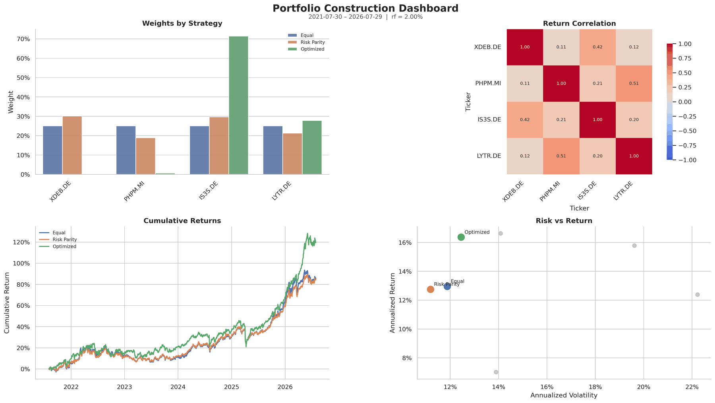
Evidence is reviewed as one system
Weights, correlations, performance, and risk are evaluated together—not metric by metric.
A-CLUSTER All-Weather / Macro Regime Portfolio | Yahoo Finance data | Monthly rebalance
16

Slide 17
Full-sample strategy comparison
Optimization looks best in-sample, but concentration rises sharply.
Strategy
Return
Volatility
Sharpe
Max DD
Effective N
1.70
3.85
Equal
12.95%
11.88%
0.922
-12.67%
4.00
Optimized effective N
Risk Parity effective N
Risk Parity
12.75%
11.19%
0.961
-13.13%
3.85
Optimized
16.37%
12.45%
1.154
-17.07%
1.70
INTERPRETATION
The optimizer increased Sharpe ratio in-sample but concentrated the portfolio heavily in the best historical risk-return trade-off.
Risk Parity accepted a lower in-sample return in exchange for broader risk diversification.
The effective number of holdings is the warning signal: higher performance with lower effective N can indicate fragility.
A-CLUSTER All-Weather / Macro Regime Portfolio | Yahoo Finance data | Monthly rebalance
17

Slide 18
Forward validation favors robust diversification
Risk Parity and Equal Weight preserved the four-regime structure when tested forward.
Strategy
Return
S&P 500
Sharpe
Alpha
Beta
Max DD
Risk Parity
Equal
Risk Parity
19.9%
13.9%
1.18
13.09%
0.25
8.0%
Winner
Alternative
Equal
20.0%
13.9%
1.11
12.85%
0.29
8.4%
Optimized
7.6%
13.9%
0.30
3.37%
0.16
9.7%
RESEARCH LESSON
The optimized portfolio was a strong historical fit, but weaker forward performance shows the cost of estimation error.
Risk Parity did not require expected return forecasts and therefore preserved broader macro diversification.
Equal Weight remained very competitive, supporting the view that the selected universe is economically coherent.
A-CLUSTER All-Weather / Macro Regime Portfolio | Yahoo Finance data | Monthly rebalance
18

Slide 19
Risk Parity preserves all four macro roles
The final allocation retains every regime sleeve.
Ticker
Portfolio role
Weight
IS3S
31.0%
IS3S.DE
Value equity / return engine
31.0%
XDEB.DE
Defensive global equity
27.9%
XDEB
27.9%
LYTR.DE
Commodity inflation hedge
22.8%
LYTR
22.8%
PHPM.MI
Precious metals crisis hedge
18.3%
PHPM
18.3%
WHY THIS IS COHERENT
Equity exposure is split between defensive and value factors.
Real-asset exposure is split between broad commodities and precious metals.
No single ETF dominates the capital allocation or the macro narrative.
A-CLUSTER All-Weather / Macro Regime Portfolio | Yahoo Finance data | Monthly rebalance
19

Slide 20
Risk Parity fits an all-weather objective
It distributes risk without forecasting which regime will win next.
No return forecast
Balanced risk budget
Uses risk estimates rather than expected-return forecasts.
Prevents one asset from dominating the portfolio’s behavior.
Regime resilience
Lower estimation error
Keeps exposure to equities, commodities, and precious metals.
Less sensitive than mean-variance optimization to small data changes.
Risk Parity is not the highest-return rule in every sample. Its value is reducing dependence on any single regime forecast or return estimate.
A-CLUSTER All-Weather / Macro Regime Portfolio | Yahoo Finance data | Monthly rebalance
20

Slide 21
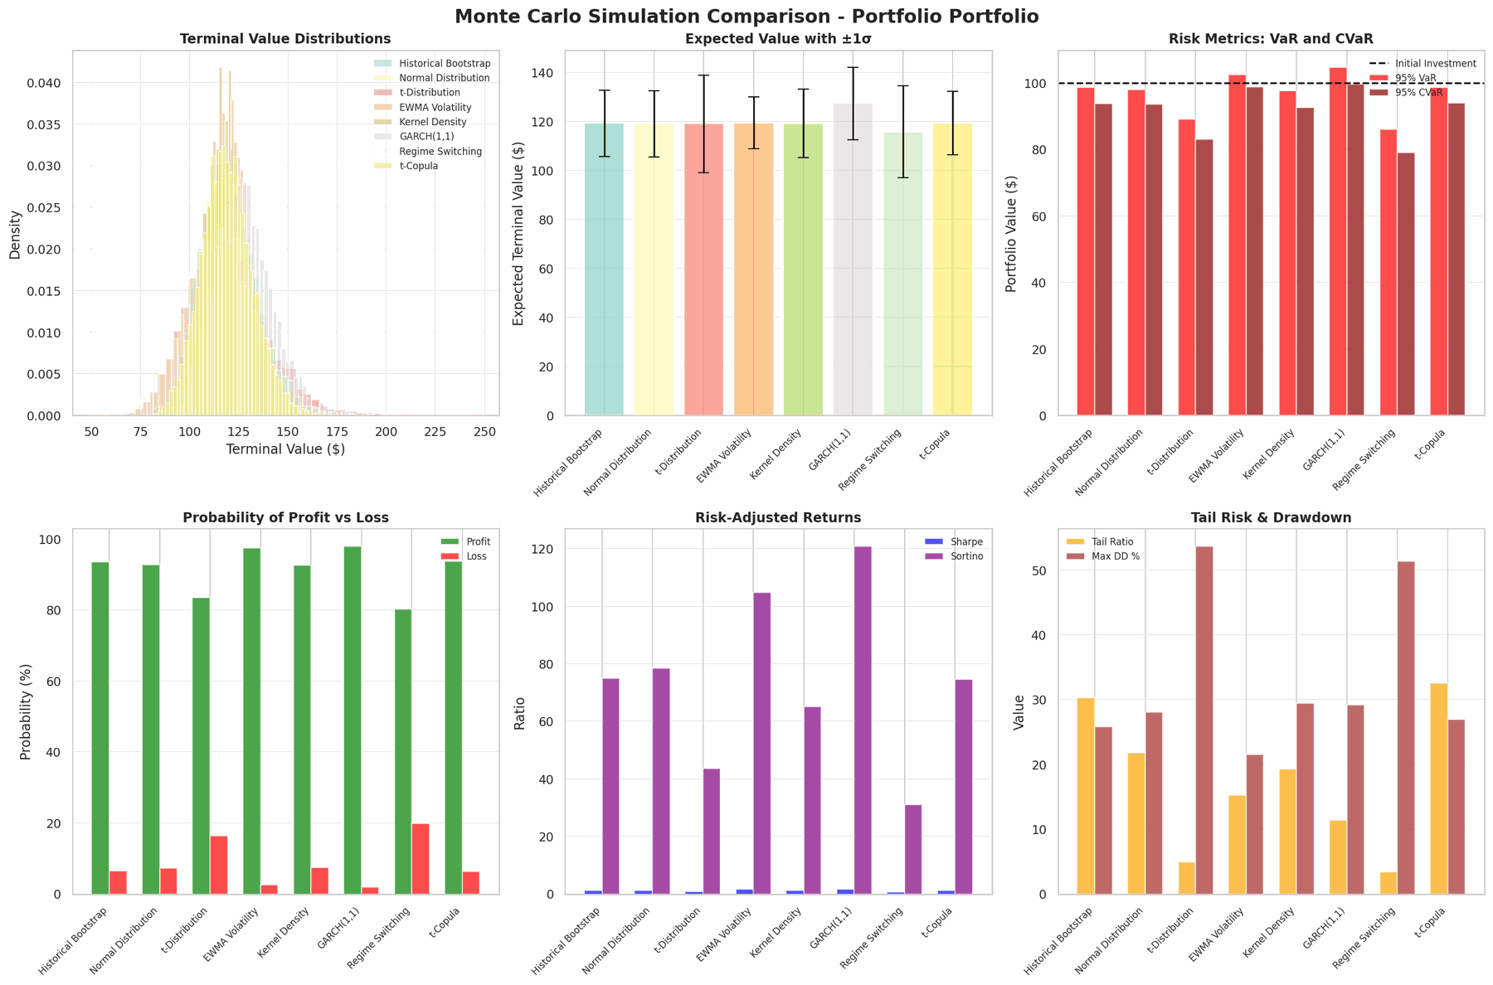
Monte Carlo: method comparison
Multiple simulation engines confirm a positive central tendency but expose tail sensitivity.
A-CLUSTER All-Weather / Macro Regime Portfolio | Yahoo Finance data | Monthly rebalance
21

Slide 22
Monte Carlo summary
Expected returns are positive across methods; tail models are materially more conservative.
Method
Expected Value
Expected Return
95% VaR
Profit Prob
Sharpe
Max DD
Historical Bootstrap
$119.17
+19.2%
$98.60
93.5%
1.28
-25.8%
EWMA Volatility
$119.31
+19.3%
$102.45
97.4%
1.64
-21.5%
GARCH(1,1)
$127.25
+27.2%
$104.67
98.0%
1.72
-29.2%
t-Distribution
$118.97
+19.0%
$89.20
83.6%
0.86
-53.7%
Regime Switching
$115.75
+15.7%
$86.07
80.2%
0.74
-51.3%
IMPLICATION
The central case is positive, but tail-aware and regime-switching models reduce the safety margin materially.
The portfolio should be presented as all-weather and resilient—not risk-free.
Stress testing remains part of the monthly governance process.
A-CLUSTER All-Weather / Macro Regime Portfolio | Yahoo Finance data | Monthly rebalance
22

Slide 23
Stress tests define the limits of all-weather protection
Diversification can soften shocks; it cannot eliminate capital loss.
Scenario
Expected Value
Expected Return
95% VaR
Profit Prob
Sharpe
93.6%
47.7%
Base Case
$119.01
19.0%
$98.66
93.6%
1.29
2008 Financial Crisis
$102.59
2.6%
$54.52
47.7%
0.02
Base profit probability
2008 stress profit probability
COVID-19 Crash
$106.97
7.0%
$65.10
54.5%
0.17
Dot-com Bubble
$111.27
11.3%
$74.37
64.2%
0.37
RISK POLICY
Inflation Shock
$115.00
15.0%
$86.02
76.9%
0.66
Stress tests justify position sizing and rebalancing discipline.
A severe liquidity event can still dominate diversification benefits temporarily.
The role of PHPM and LYTR is protection against specific shocks, not guaranteed positive returns.
A-CLUSTER All-Weather / Macro Regime Portfolio | Yahoo Finance data | Monthly rebalance
23

Slide 24
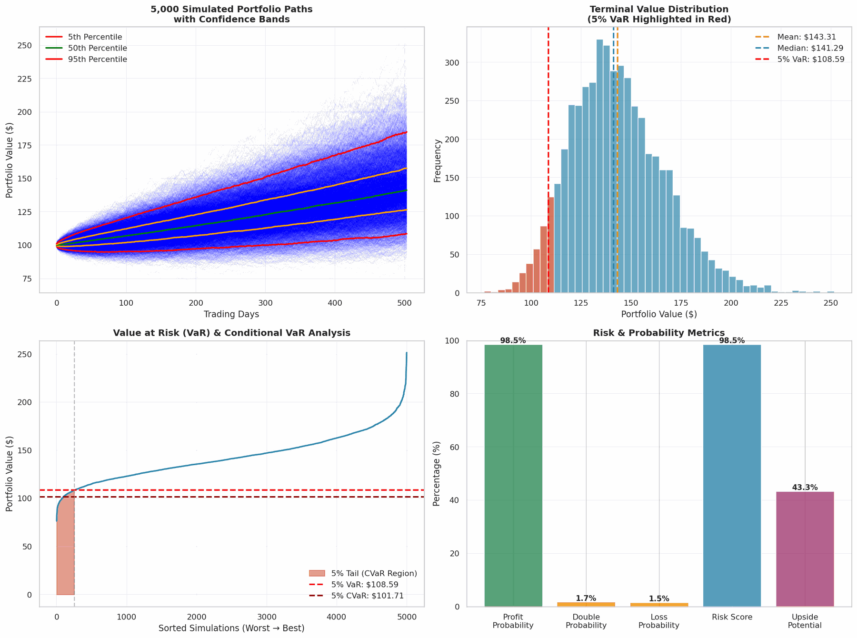
Monte Carlo: simulated paths and distribution
The distribution is positively skewed in the central simulation, with explicit VaR and CVaR monitoring.
A-CLUSTER All-Weather / Macro Regime Portfolio | Yahoo Finance data | Monthly rebalance
24

Slide 25
Implementation policy: Research · Rebalance · Resilience
Turn the all-weather concept into a repeatable monthly service.
Rule
Policy
Universe
Remain confined to XDEB, IS3S, PHPM, LYTR unless a new instrument forms a distinct behavior cluster.
Default allocation
Risk Parity; Equal Weight remains the benchmark and fallback allocation.
Rebalancing
Monthly review; rebalance when weights or risk exposures drift materially from policy.
Risk monitoring
Track volatility, drawdown, beta, VaR, CVaR, and correlation shifts.
Optimizer use
Use unconstrained mean-variance optimization diagnostically; avoid using it directly without constraints.
Rebalancing is not trading. Rebalancing is risk management.
A-CLUSTER All-Weather / Macro Regime Portfolio | Yahoo Finance data | Monthly rebalance
25

Slide 26
All-weather still requires active governance
A diversified regime framework remains a research process—not a promise.
LIMITATIONS
NEXT RESEARCH
Backtests are sample-dependent and sensitive to ETF history length.
Yahoo Finance data can contain missing values, currency effects, and corporate-action adjustments.
Monte Carlo output depends heavily on the assumed distribution and volatility model.
The portfolio has no bond sleeve, so defensive behavior comes from diversification rather than duration.
Run rolling walk-forward tests with fixed estimation windows.
Test constrained optimization against Risk Parity and Equal Weight.
Add regime diagnostics: inflation trend, real yields, credit spreads, and equity breadth.
Create a monthly factsheet with targets, realized risk, and drift from allocation policy.
The defensible claim is robustness across tested regimes—not that the portfolio always wins.
A-CLUSTER All-Weather / Macro Regime Portfolio | Yahoo Finance data | Monthly rebalance
26

Slide 27
Appendix A | Product structure terms
Definitions of the instruments and implementation structures used in the portfolio.
TRADED PRODUCTS
IMPLEMENTATION
ETF — Exchange-traded fund holding a portfolio of assets or instruments.
ETC — Exchange-traded commodity product; legally distinct from a UCITS fund.
UCITS — EU framework governing eligible collective investment funds.
Benchmark — Reference index used to define or evaluate an investment strategy.
Physical replication — Direct ownership of the underlying assets or representative sample.
Synthetic replication — Index exposure obtained through a derivative contract.
Accumulating share class — Reinvests distributable income rather than paying it out.
TER — Annual operating expenses expressed as a percentage of fund assets.
Product structure and investment behavior are related—but they are not interchangeable.
A-CLUSTER All-Weather / Macro Regime Portfolio | Glossary appendix
27

Slide 28
Appendix B | Portfolio architecture terms
The language used to describe the portfolio’s economic structure and diversification.
MACRO FRAMEWORK
PORTFOLIO STRUCTURE
All-weather portfolio — Allocation designed to remain functional across multiple economic regimes.
Macro regime — Environment shaped by growth, inflation, policy, liquidity, and market stress.
Return driver — Economic exposure expected to influence an asset’s performance.
Portfolio sleeve — Group of holdings assigned a distinct role within the portfolio.
Diversification — Combining independent drivers to reduce reliance on one outcome.
Concentration — Dependence on a limited number of holdings, factors, or macro exposures.
Capital weight — Percentage of portfolio value invested in a holding.
Portfolio drift — Movement away from policy targets as prices and risk estimates change.
Diversification is the independence of portfolio functions—not simply the number of holdings.
A-CLUSTER All-Weather / Macro Regime Portfolio | Glossary appendix
28

Slide 29
Appendix C | Allocation and risk terms
Definitions used to compare allocation rules and interpret portfolio behavior.
ALLOCATION RULES
RISK MEASURES
Equal Weight — Assigns the same capital allocation to each ETF.
Risk Parity — Allocates capital so no sleeve dominates estimated portfolio risk.
Mean-variance optimization — Selects weights from modeled returns, volatility, and correlations.
Risk budget — Target share of total modeled risk assigned to each sleeve.
Modeled risk contribution — Estimated amount of portfolio risk attributable to one holding.
Volatility — Dispersion of returns; a variability measure, not a complete definition of risk.
Beta — Sensitivity of an investment to movements in a reference market.
Drawdown — Decline from a portfolio peak to a subsequent trough.
Capital weights show where money is invested; risk contributions show modeled influence on risk.
A-CLUSTER All-Weather / Macro Regime Portfolio | Glossary appendix
29

Slide 30
Appendix D | Evidence and validation terms
The methods used to distinguish historical evidence from model-based future scenarios.
HISTORICAL EVIDENCE
MODEL-BASED EVIDENCE
Backtest — Historical application of rules using past data and stated assumptions.
Forward validation — Evaluation on a period not used to calibrate the allocation.
Historical bootstrap — Simulation created by resampling observed historical returns.
Correlation — Degree to which two return series move together in a specified sample.
Monte Carlo simulation — Many plausible paths generated from an explicit statistical model.
EWMA volatility — Volatility estimate giving greater weight to recent observations.
GARCH(1,1) — Model in which volatility changes through time and clusters after shocks.
Regime switching — Model allowing return behavior to vary between distinct states.
Observed data, model estimates, and investment judgment should always remain clearly separated.
A-CLUSTER All-Weather / Macro Regime Portfolio | Glossary appendix
30

Slide 31
Appendix E | Tail risk and governance terms
Definitions supporting the portfolio’s stress testing and monthly control process.
TAIL RISK
GOVERNANCE
VaR — Loss threshold expected not to be exceeded at a chosen confidence level and horizon.
CVaR / Expected Shortfall — Average loss beyond the VaR threshold.
Tail risk — Exposure to rare outcomes with unusually large losses.
Stress test — Portfolio response under severe but explicitly defined scenarios.
Rebalancing — Restoring capital weights or risk exposures toward policy targets.
Resilience — Ability to remain functional across adverse conditions; not immunity from loss.
Risk management — Process for identifying, measuring, limiting, and reviewing failure paths.
Governance — Rules, authority, evidence, and actions used to keep the portfolio aligned with purpose.
Model output informs decisions; it does not replace judgment, policy, or governance.
A-CLUSTER All-Weather / Macro Regime Portfolio | Glossary appendix
31

Slide 32
Final recommendation
Adopt Risk Parity as the default implementation of the A-CLUSTER All-Weather / Macro Regime Portfolio.
Allocation
Role
Decision logic
IS3S 31.0%
Global value equity return engine
Risk Parity preserved all four macro roles, outperformed the optimized rule in forward validation, and avoided excessive concentration.
XDEB 27.9%
Defensive global equity exposure
LYTR 22.8%
Commodity inflation hedge
Keep Equal Weight as benchmark; keep unconstrained optimization as diagnostic.
PHPM 18.3%
Precious metals crisis hedge
Research · Rebalance · Resilience | Monthly portfolio governance

